Slide 1

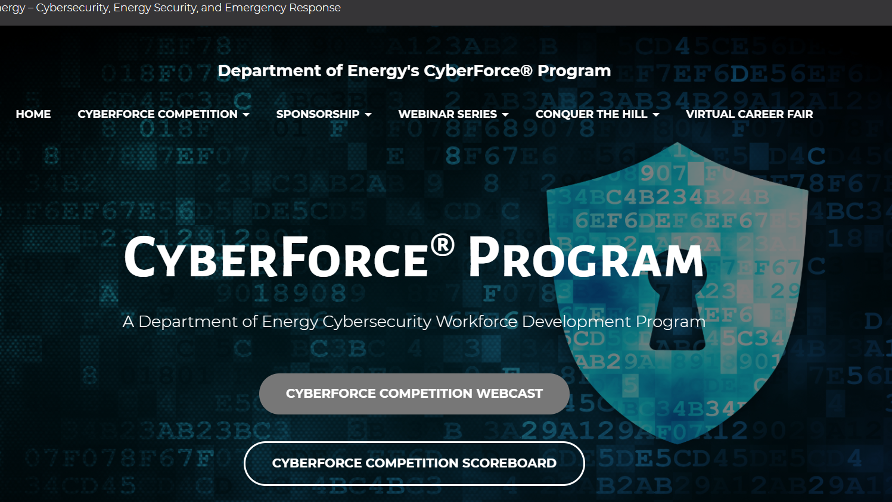


Red Team… Core Edition….
https://cyberforcecompetition.com/
Behind the Scene
Notes:
Department of Energy's CyberForce® Program (cyberforcecompetition.com)
2021 President's Cup Cybersecurity Competition Preview – YouTube
WRCCDC | Western Regional Collegiate Cyber Defense Competition

Slide 2

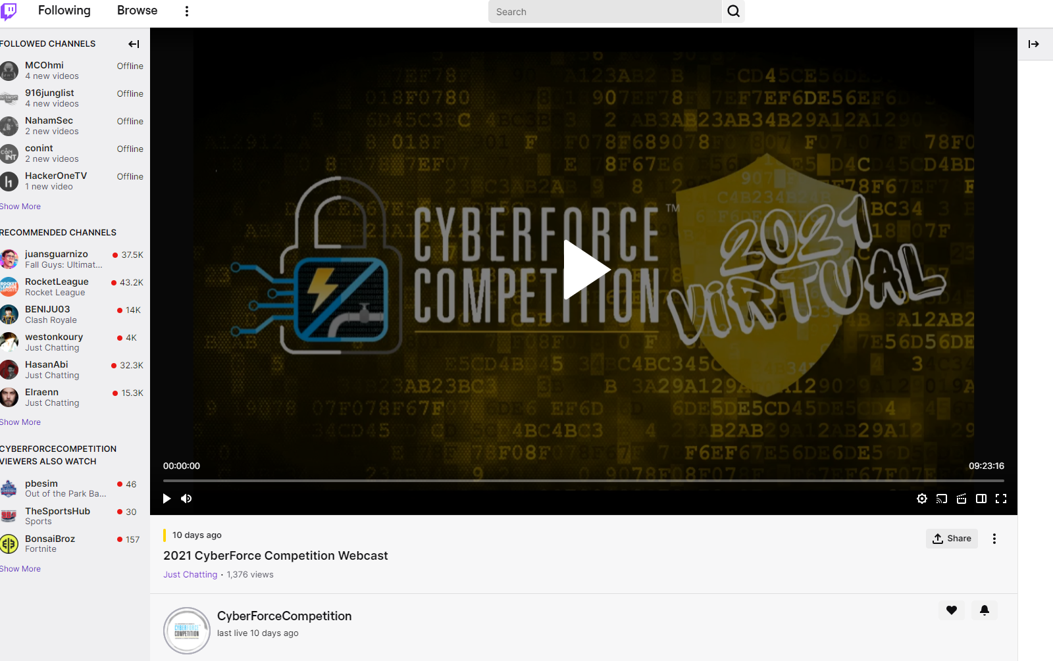
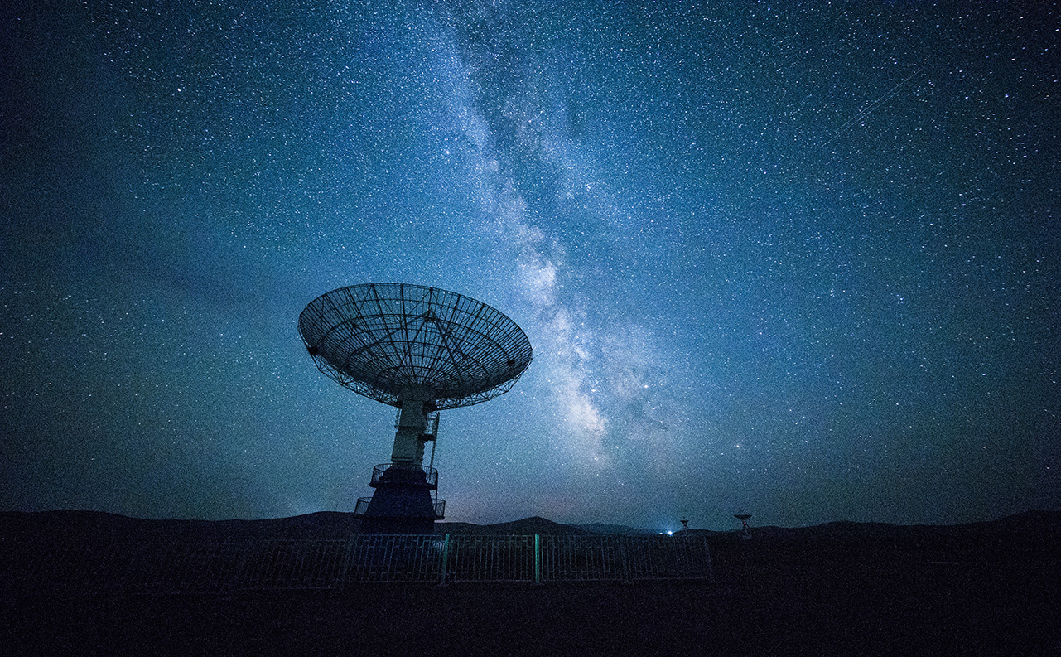
Global technology
Smart Product
Voice Recognition
Artificial Intelligence
VR
2021 CyberForce Competition Webcast – Twitch
CyberForce Competition - YouTube
Notes:
2021 CyberForce Competition Webcast – Twitch
CyberForce Competition – YouTube

Slide 3
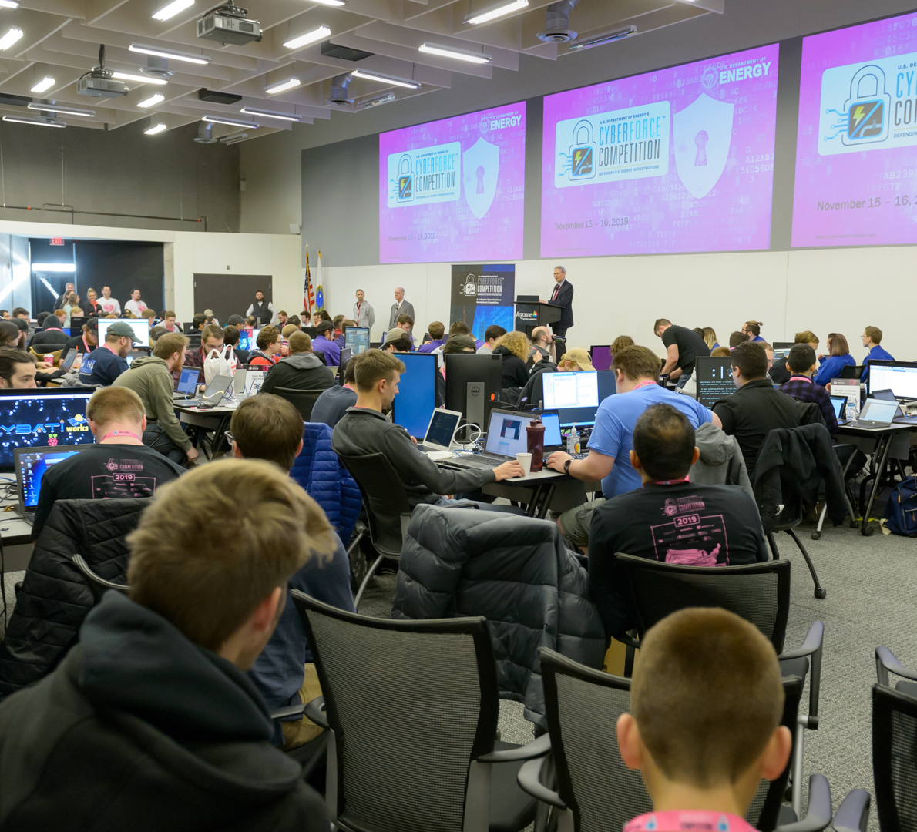
BlueTeam room
Notes:
https://cyberforcecompetition.com/cyberforce/prior-competitions/doe-cyberforce-competition-2019/

Slide 4
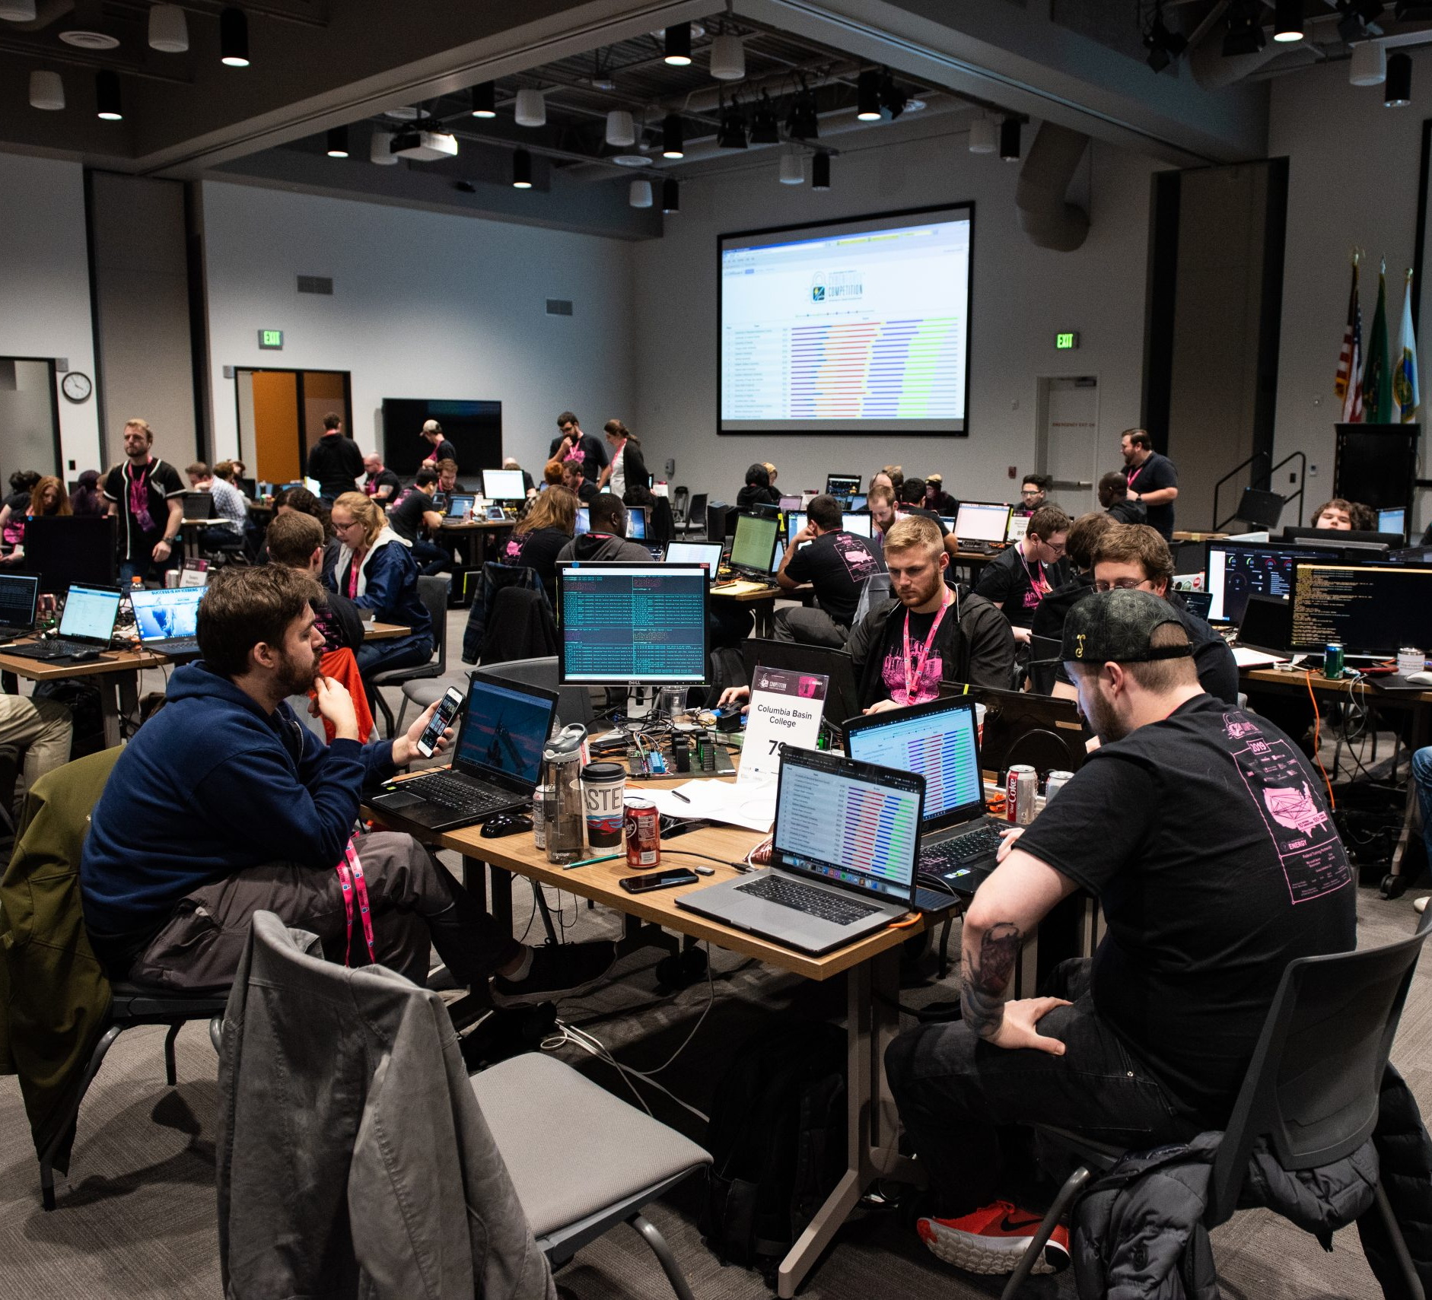
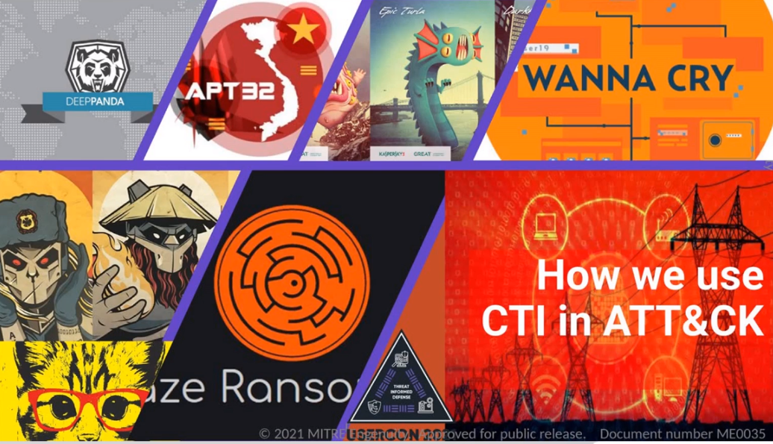
Red Team?

Slide 5
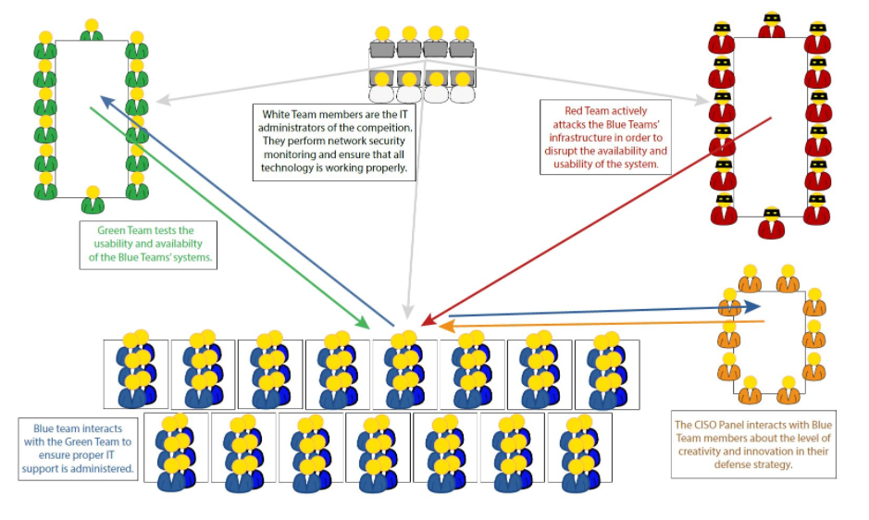
Other areas
Notes:
CyberForce Competition – Department of Energy's CyberForce® Program

Slide 6
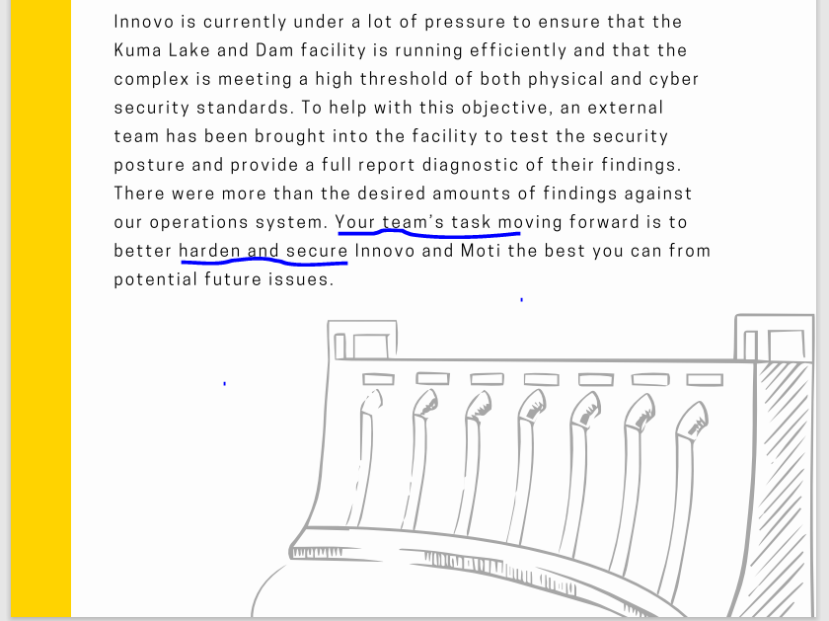
TASKS: Secure Environment
https://cyberforcecompetition.com/cyberforce/scenario/
Notes:
CyberForce Competition – Department of Energy's CyberForce® Program

Slide 7
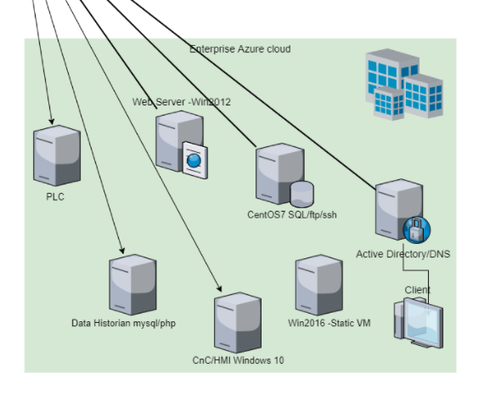


INFRA??? AZURE cli cmds
Notes:
https://cyberforcecompetition.com/cyberforce/prior-competitions/doe-cyberforce-competition-2019/
Scenario – Department of Energy's CyberForce® Program (cyberforcecompetition.com)

Slide 8
Playbook
Notes:
Sysmon inject Sticky keys MySQL Canarytoken WMI port knock to reverse shell

Slide 9
Discord and 135 Blueteams

Slide 10
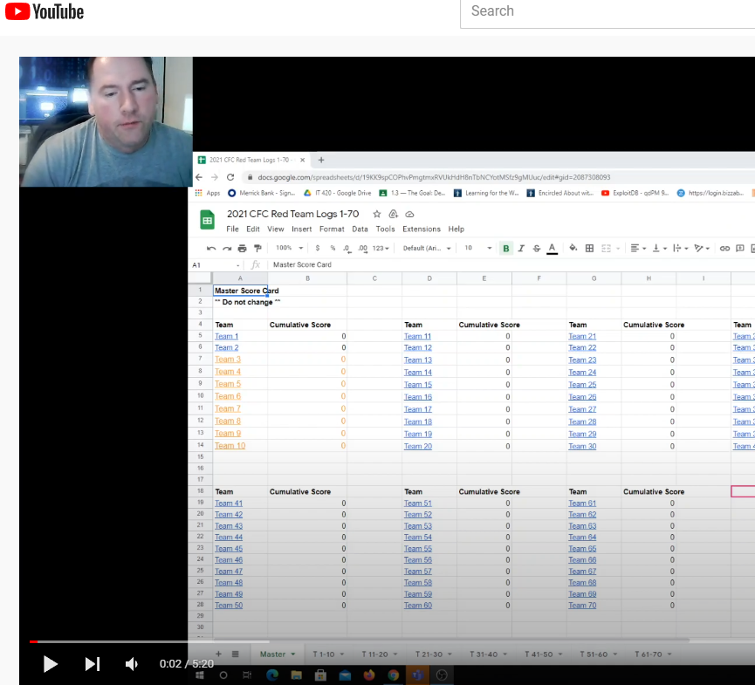
Scoring
CyberForce2021 Scoring - YouTube

Slide 11
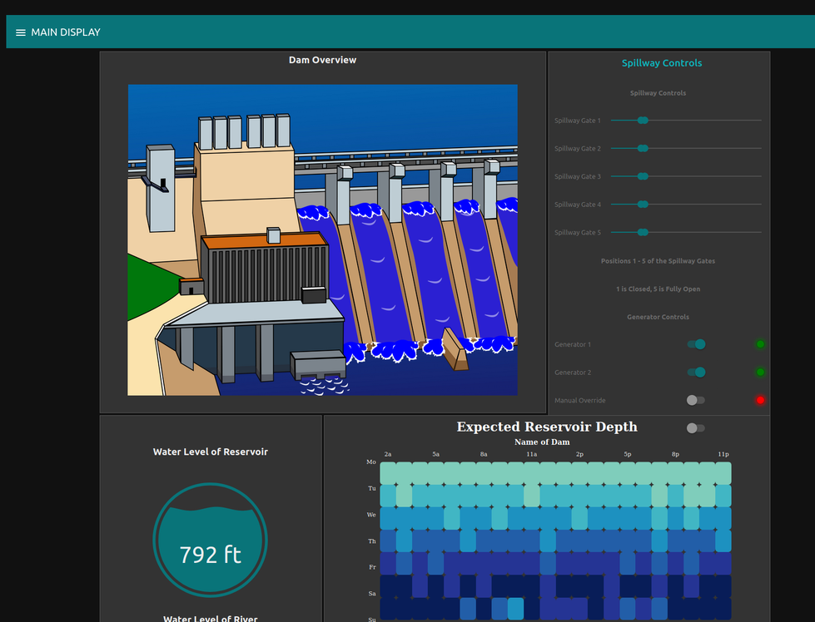
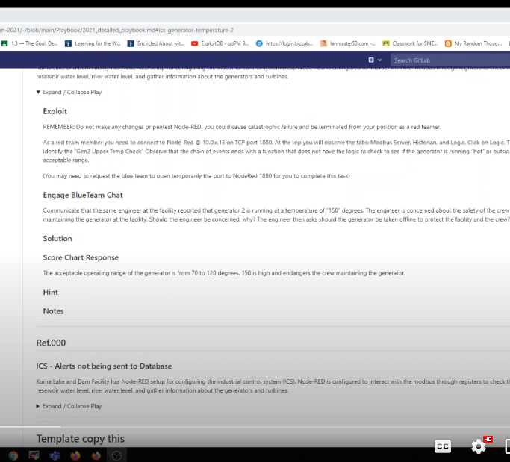
ICS Exploit Temp
ICS Gen2 Temperature - YouTube
Notes:
ICS Gen2 Temperature - YouTube

Slide 12
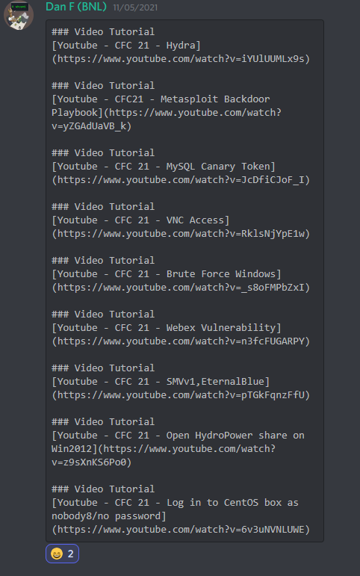
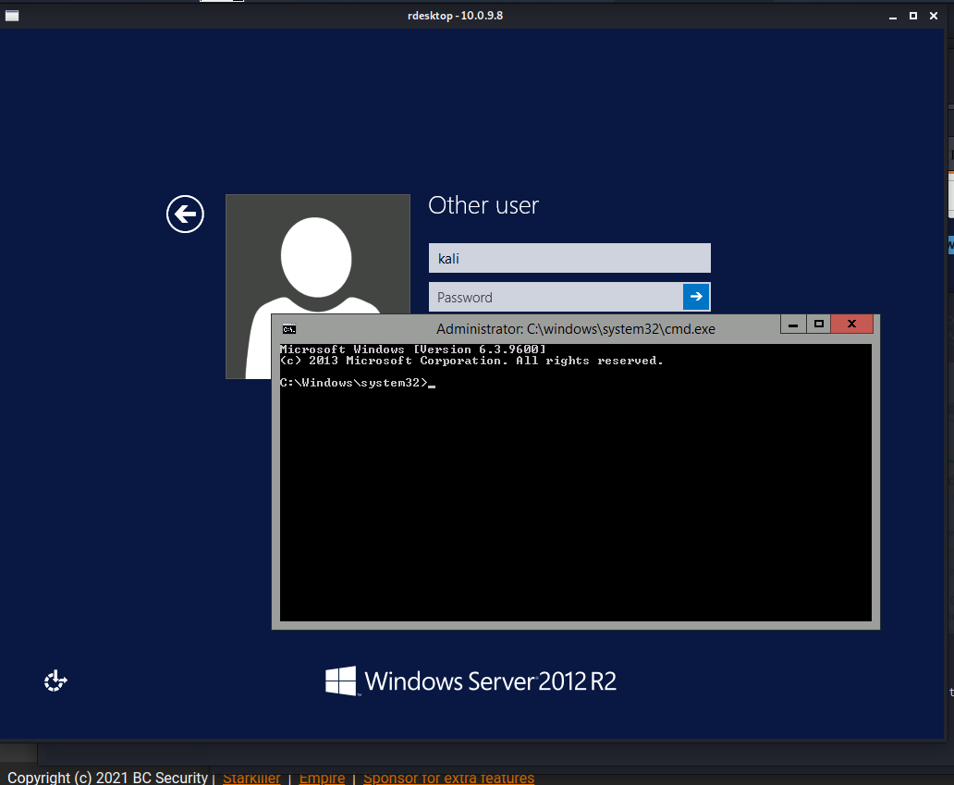
StickyKeys
https://screencast-o-matic.com/watch/cYiVcu5Ytt
Notes:
https://screencast-o-matic.com/watch/cYiVcu5Ytt
### Video Tutorial[Youtube - CFC 21 –
Hydra](https://www.youtube.com/watch?v=iYUlUUMLx9s)
### Video Tutorial[Youtube - CFC21 - Metasploit Backdoor Playbook](https://www.youtube.com/watch?v=yZGAdUaVB_k)
### Video Tutorial[Youtube - CFC 21 - MySQL Canary Token](https://www.youtube.com/watch?v=JcDfiCJoF_I)
### Video Tutorial[Youtube - CFC 21 - VNC Access](https://www.youtube.com/watch?v=RklsNjYpE1w)
### Video Tutorial[Youtube - CFC 21 - Brute Force Windows](https://www.youtube.com/watch?v=_s8oFMPbZxI)
### Video Tutorial[Youtube - CFC 21 - Webex Vulnerability](https://www.youtube.com/watch?v=n3fcFUGARPY)
### Video Tutorial[Youtube - CFC 21 - SMVv1,EternalBlue](https://www.youtube.com/watch?v=pTGkFqnzFfU)
### Video Tutorial[Youtube - CFC 21 - Open HydroPower share on Win2012](https://www.youtube.com/watch?v=z9sXnKS6Po0)
### Video Tutorial[Youtube - CFC 21 - Log in to CentOS box as nobody8/no password](https://www.youtube.com/watch?v=6v3uNVNLUWE)

Slide 13
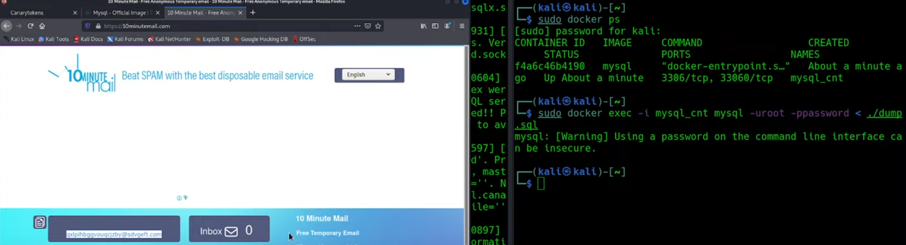
CanaryToken
https://www.youtube.com/watch?v=JcDfiCJoF_I
Notes:
Video Tutorial[Youtube - CFC 21 - MySQL Canary Token](https://www.youtube.com/watch?v=JcDfiCJoF_I

Slide 14
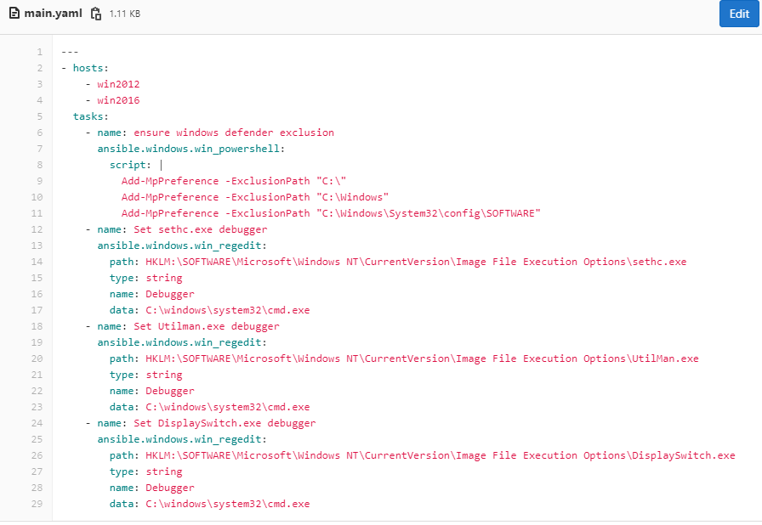
Ansible

Slide 15
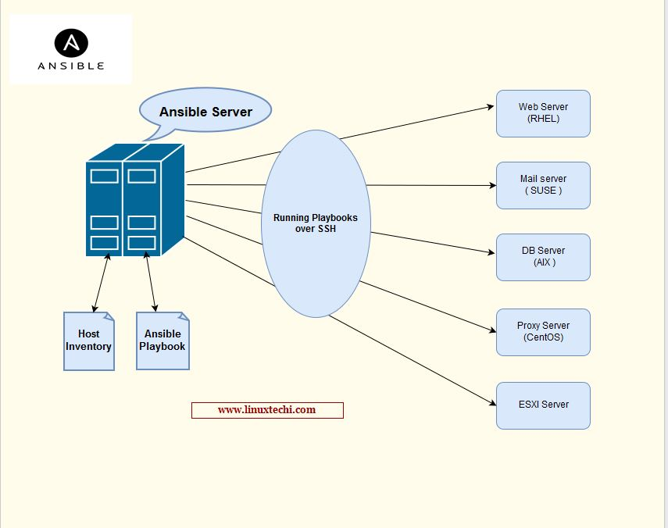
Ansible

Slide 16
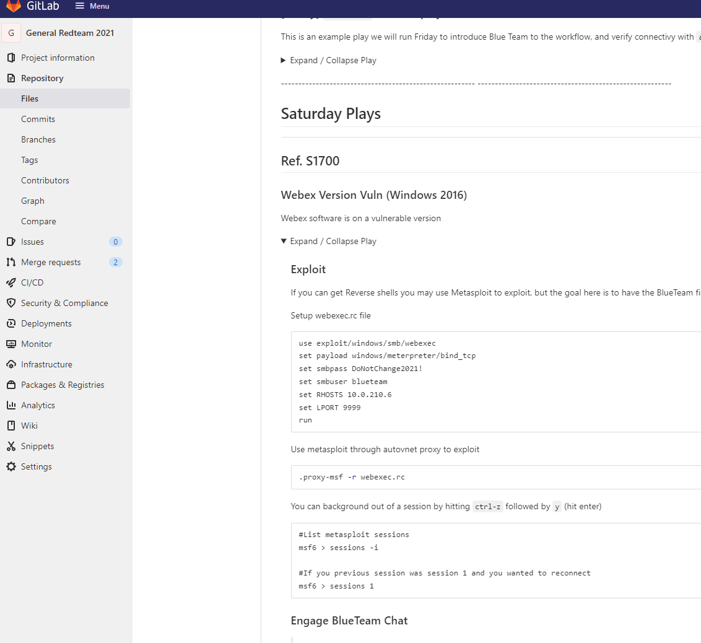
GAMEDAY

Slide 17
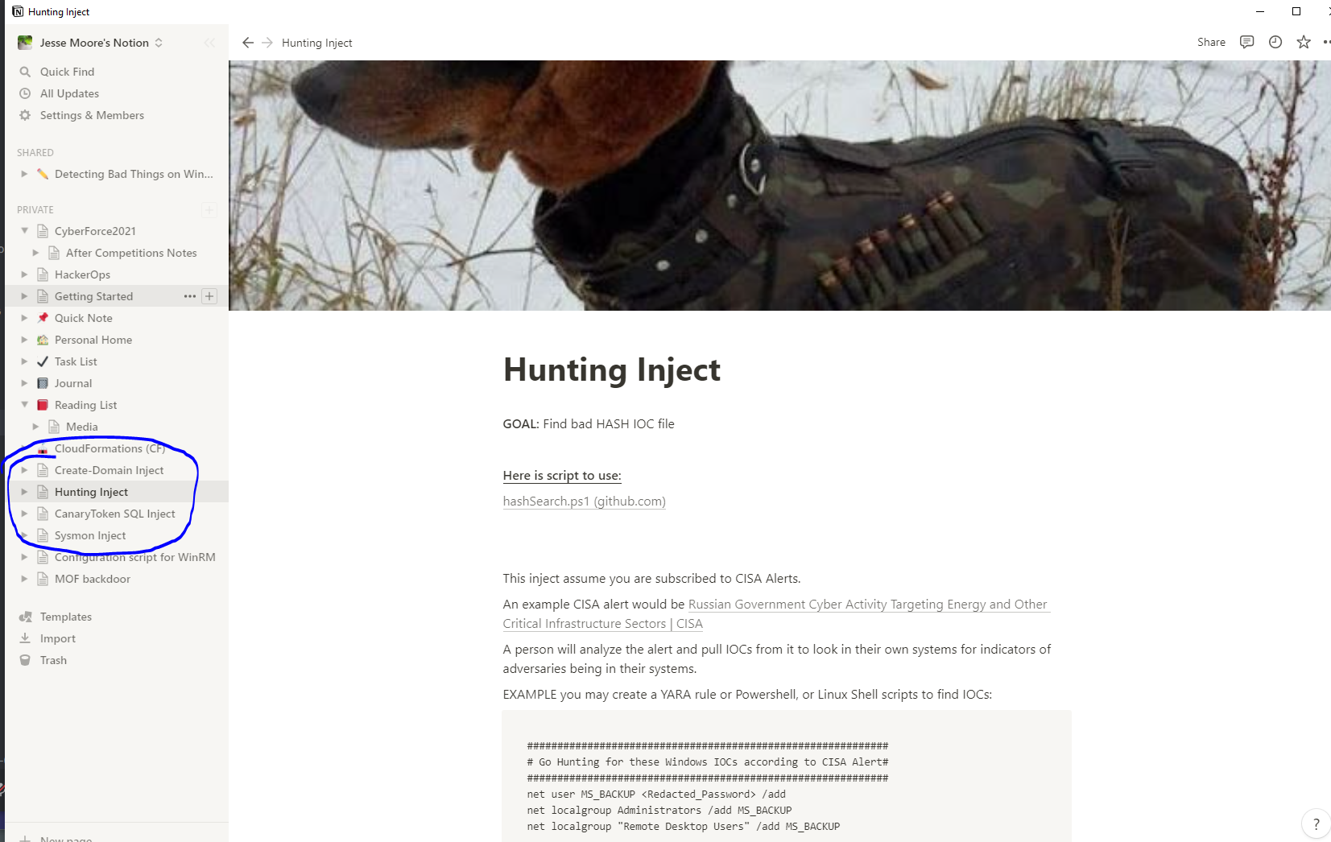
Notion

Slide 18
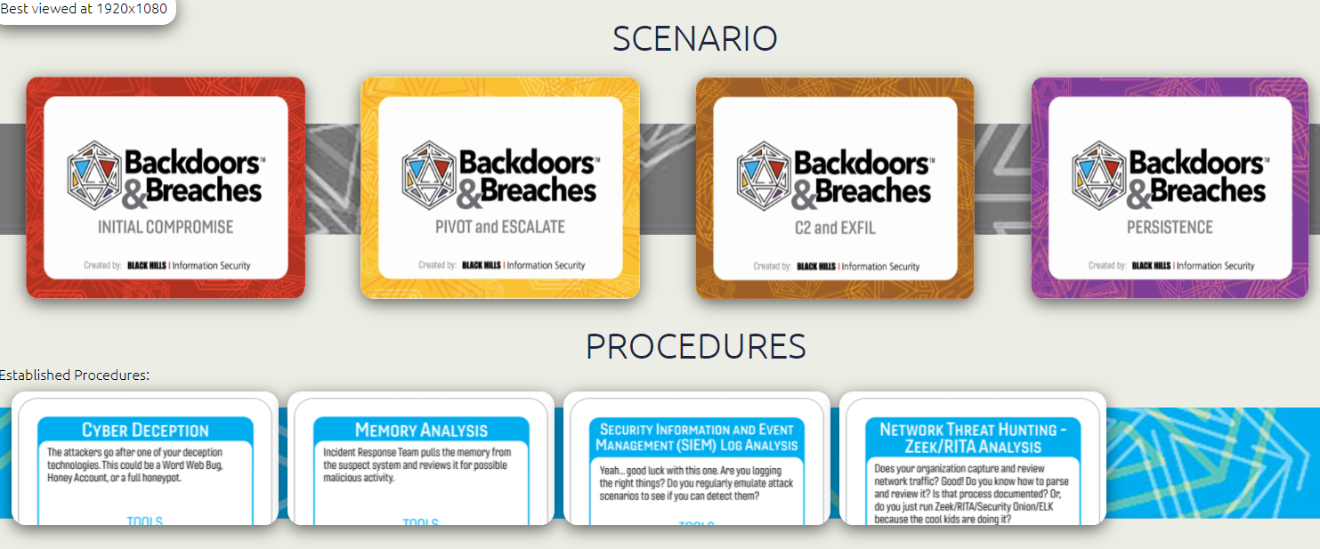
Thank You!
Check what Attackers do and how Admins needs to respond???
moorej1@uw.edu
https://www.blackhillsinfosec.com/projects/backdoorsandbreaches/
Notes:
B&B Shuffle by Richard Phung/P3hndrx (backdoorsandbreaches.com)
https://github.com/ch33r10/EnterprisePurpleTeaming
scythe-io/purple-team-exercise-framework: Purple Team Exercise Framework (github.com)

Slide 19
Please Join Security Advocates email: ciso@uw.edu
https://ciso.uw.edu/education/outreach/infosec-advocates/

